Slide 1
Summary of CECOM’s Work on MIMOSA Registry and Metadata Tags
Pam Ludwig
Dr. Xinxin Wang
CECOM CBM+
wang_xinxin@bah.com
CBM+ File and Messaging Workshop
June 12-14, 2012

Slide 2
Initial Work
Understood what TACOM and LOGSA did from last File and Message Workshop
Identified basic scenarios derived from some CECOM platforms
TQG MAP 805B
CPP AN/TSQ-232
Manually populated MIMOSA tables using Excel spread sheets
Collaborated with the LOGSA and LRC teams to identify and resolve issues
Notes:
The CECOM team attended the last File & Messaging Workshop in Huntsville. We learned a lot from the workshop and realized that we need to speed up the process of helping LOGSA team to populate MIMOSA registry for CECOM EOA II.

Slide 3
ABCD File Examples
Analyzed existing ABCD files generated by Impact and AMSAA
Created ABCD file examples using a registry generated for the basic scenarios
Followed LOGSA Naming conventions and ABCD File Best Practices
Reviewed the ABCD example files with the LOGSA and LRC teams
Notes:
My teammate Gary Hellenga will have a session tomorrow talking about our work on ABCD file analysis.

Slide 4
ABCD File Validation Process
Created a validation process that enforces the compliance with
LOGSA Naming Conventions
ABCD File Best Practices
Does not currently included metadata tags for Multicolumn and Histogram
Will need to combine the validation process with LOGSA’s existing process and TACOM’s process to create a common process
Notes:
The first draft of the ABCD File Validation Process is provided as back-up slides

Slide 5
ABCD Files – Future Considerations
Optional metadata tags for zVariables to specify a data source asset (e.g. a sensor)
LVL90 user tags best practices
LVL90 tags vs. DM level zVariables
Common LVL90 tags for all platforms vs. custom LVL90 tags for each individual platform
Best practices to break large ABCD files to smaller ones
A common ABCD file library
Parses ABCD files
Allows custom post-processing
A common ABCD file validation tool
Compliance of LOGSA Naming Conventions
Compliance of ABCD File Best Practices
As a part of the common ABCD file library or a Web service
Notes:
During this process, we identified some future considerations.
Item 4: LOGSA and CECOM may store the sensor data in different ways (e.g. LOGSA doesn’t use MIMOSA meas_event tables, but CECOM does). A common ABCD file parser that supports custom post-processing can be still used by both systems.
Item 5: The ABCD file validation can be included in a common library or a web service. Using a synchronous web service will have performance issue because an ABCD file can be very large. Using an asynchronous service is not easy to use as a part of a common library. However, using a common library requires version maintenance.

Slide 6
Repeatable Registration Processes
Studied the Interactive Electronic Technical Manuals (IETMs) to understand decomposition of some CECOM platforms
Defined criteria used to determine which objects to add to the CBM+ registry
Created hypothetical models, assets and sensor configurations that incorporate all possible scenarios
Proposed an approach to represent the hypothetical models, assets and sensor configurations using MIMOSA tables
Drafted four registration process:
Model Registration Process
Measurement Configuration Process
Asset Registration Process
Replaceable Unit (RU) Installation Process
Notes:
*We may be able to populate MIMOSA registry manually for CBM+ EOA because we only use limited number of platforms. However, we will need to automate the process in the future. Therefore, we need to identify a set of repeatable registration processes common to all MACOMs.
*We will have a discussion session tomorrow for more details

Slide 7
Registration Data Retrieval
Identified AIA compliant data services to
Retrieve data from a SV-11 compliant registry
Expose sensor data to applications for end users
Defining Service Interfaces for these data services
Notes:
*We will have a session on Thursday for more details

Slide 8
Registration - Future Work
Refine the processes based on feedback from LOGSA and TACOM
Create a reusable tool to automate the registration processes
Use the tool to populate all platforms and measurement configurations for CECOM EOA II to a CLOE SV-11 compliant database
Provide a copy of the tool with XML input to LOGSA to populate CECOM data to the CBM+ registry for EOA II
Identify AIA compliant data services to manage the registry

Slide 9
Backup Slides

Slide 10
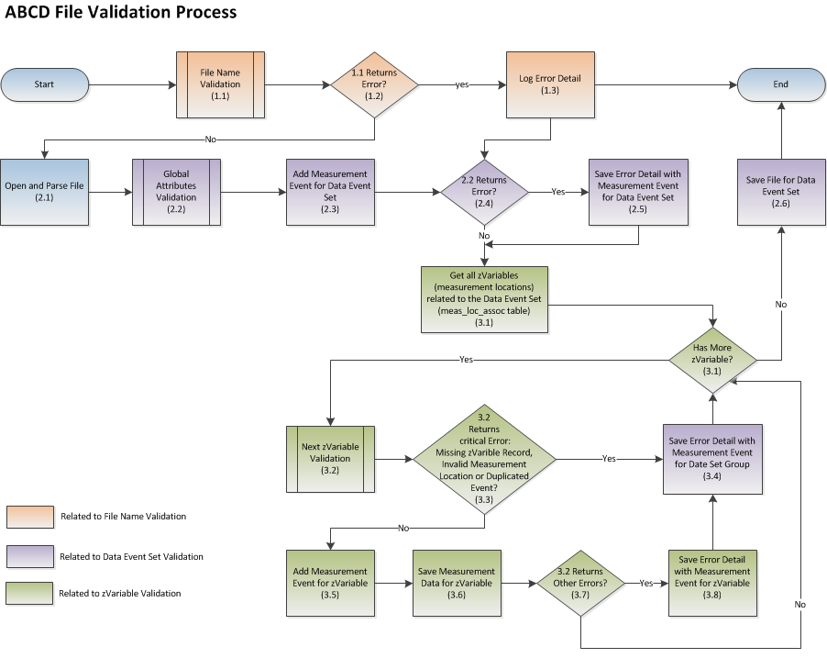

Slide 11
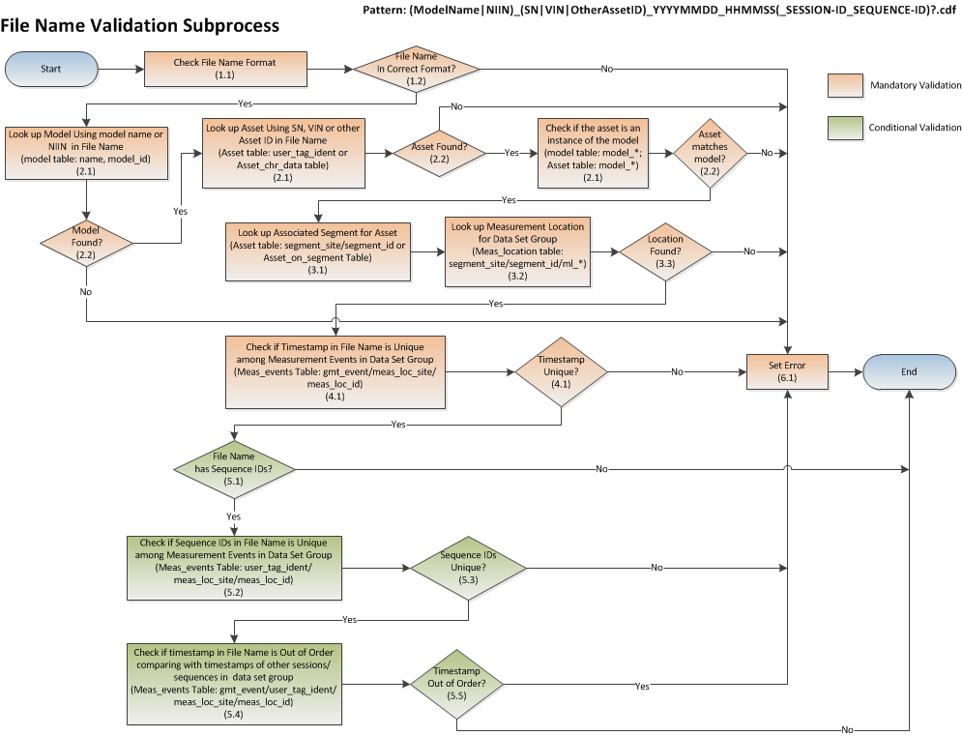

Slide 12
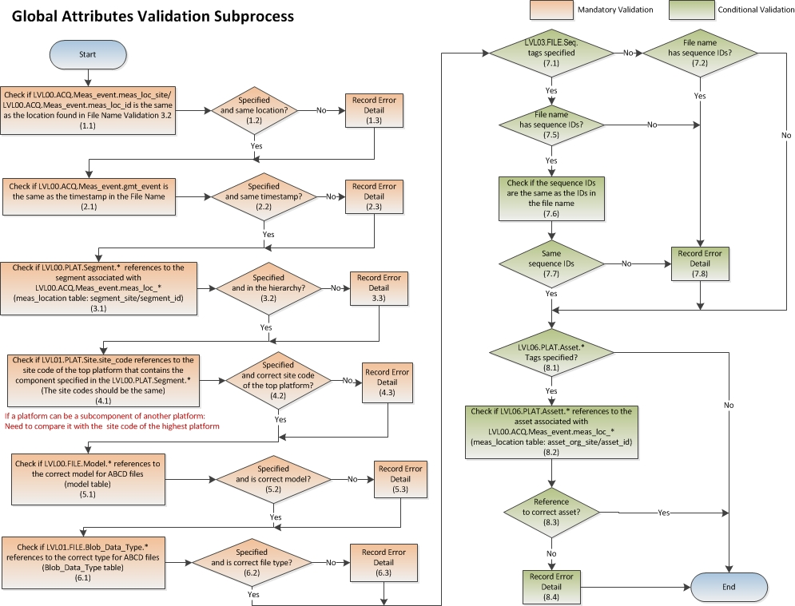

Slide 13
